Slide 1
A New Approach to Capital Markets Assumptions and Strategic Asset Allocation for US Life Insurers
Giga Nozadze
October 30, 2025

Slide 2
Using Forecast Error Instead of Volatility Leads to More Efficient Portfolios
Switching from volatility to forecast error changes optimal portfolios — less risk, better capital efficiency
Figure 1: Current allocations (transparent) are different from optimal weights (solid)
1

Slide 3
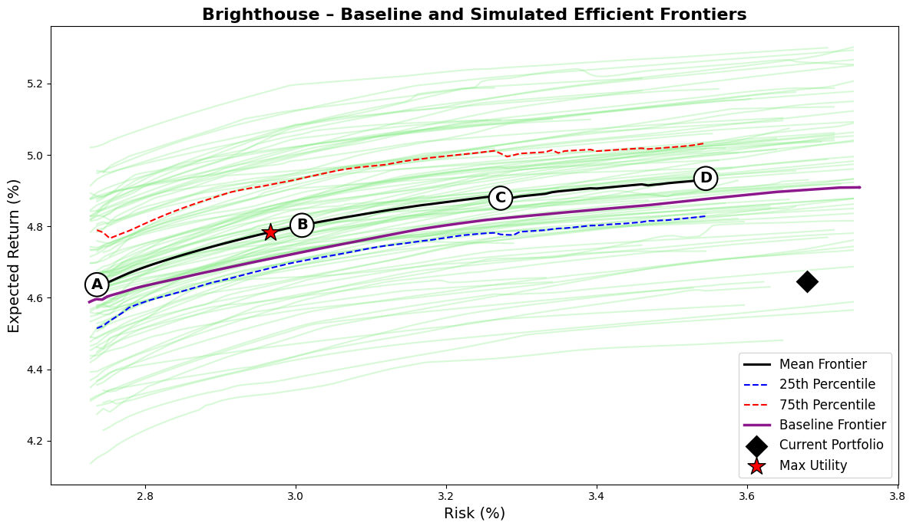
Brighthouse’s Portfolio Is Safe and Capital-Efficient — But Leaves Return on the Table
Brighthouse’s current portfolio sits inside the efficient frontier, so higher return or lower risk is possible without extra capital.
Despite a disciplined setup with strong credit quality and low capital usage, the current mix underperforms both the mean and baseline efficient frontiers.
1

Slide 4
Optimized Allocation Enhances Surplus While Preserving Capital and Credit Quality
The surplus-maximizing portfolio achieves the same return with 70 bps less risk, or 15–30 bps higher return at the same risk, all without increasing capital usage or degrading credit rating.
The optimizer reallocates toward structured credit, mortgage whole loans, and private placements, top return-to-RBC assets, while trimming global corporates and HY due to weak capital efficiency.
Metric/Asset | Current | Port A | Port B | Port C | Port D | Max Utility
Expected Return (%) | 4.65 | 4.59 | 4.72 | 4.80 | 4.84 | 4.70
Risk (%) | 3.68 | 2.74 | 3.00 | 3.25 | 3.49 | 2.95
Sharpe Ratio | 0.18 | 0.22 | 0.24 | 0.25 | 0.24 | 0.24
Avg FI Credit Rating | AA- | AA- | AA- | AA- | AA- | AA-
FI Duration (years) | 6.20 | 6.35 | 6.34 | 6.35 | 6.35 | 6.34
Net Duration (years) | 0.84 | 0.99 | 0.99 | 1.00 | 1.00 | 0.99
Capital Use (%) | 1.92 | 0.60 | 0.76 | 0.83 | 0.85 | 0.74
US Treasuries, Short/Intermediate | 3.7 | 9.9 | 6.7 | 6.1 | 4.8 | 6.7
US Treasuries, Long | 2.6 | 0.0 | 0.3 | 1.1 | 1.9 | 0.2
US Taxable Munis | 3.3 | 1.2 | 0.0 | 0.0 | 0.0 | 0.0
Global ex-US Government, hedged | 0.9 | 0.0 | 0.0 | 0.0 | 0.0 | 0.0
US Public Corporates IG AAA | 3.2 | 10.0 | 10.0 | 9.7 | 9.3 | 10.0
US Public Corporates IG AA | 6.4 | 9.9 | 6.5 | 5.4 | 3.9 | 7.0
US Public Corporates IG A | 9.6 | 9.7 | 9.3 | 9.4 | 9.1 | 9.2
US Public Corporates IG BBB | 9.2 | 0.1 | 1.8 | 2.3 | 2.4 | 1.8
US Public Corporates, HY Intermediate | 0.5 | 0.0 | 0.8 | 1.1 | 1.2 | 0.7
US Public Corporates, HY Long | 0.3 | 0.0 | 2.1 | 3.2 | 3.3 | 1.7
Global ex-US Corporates, hedged | 11.1 | 10.0 | 7.4 | 2.4 | 0.6 | 8.0
Residential Mortgage-Backed Securities | 7.4 | 8.4 | 10.0 | 10.0 | 10.0 | 10.0
Commercial Mortgage-Backed Securities | 5.8 | 9.8 | 9.4 | 9.6 | 9.3 | 9.4
Asset-Backed Securities (ABS) | 5.4 | 0.6 | 4.7 | 7.0 | 7.1 | 4.3
Corporate IG Private Placement A | 4.1 | 10.0 | 10.0 | 10.0 | 10.0 | 10.0
Corporate IG Private Placement BBB | 2.0 | 10.0 | 10.0 | 10.0 | 10.0 | 10.0
Corporate HY Private (Leveraged Loans) | 0.2 | 0.1 | 0.6 | 0.4 | 0.4 | 0.6
Residential Mortgage Whole Loans | 6.7 | 10.0 | 10.0 | 10.0 | 10.0 | 10.0
Commercial Mortgage Whole Loans | 13.4 | 0.0 | 0.4 | 2.3 | 6.7 | 0.3
Private Equity | 3.6 | 0.2 | 0.0 | 0.1 | 0.0 | 0.0
Real Estate (via partnerships, equity) | 0.6 | 0.0 | 0.0 | 0.0 | 0.0 | 0.0
1

Slide 5
Starting Yield Accurately Predicts Long-Term Bond Returns Across Sectors
Across bond types like short-term investment grade and RMBS, the starting yield explains most of the 10-year return — with R² values above 0.85 and slopes near 1.
This reinforces the case for using starting yield minus credit loss as the central input for return forecasts, especially for hold-to-maturity insurers.
Figure 3: Starting yield is a good indicators of actual returns
1

Slide 6
Mean Reversion Reduces Long-Horizon Risk, Especially in High Yield
Bond returns are not independent year to year, so mean reversion pulls weak periods back toward trend, tightening long-run outcome distributions.
This time diversification effect is strongest in high yield, where credit spreads overshoot and recover post-stress, making long-term returns more stable than short-term volatility implies.
Figure 4: Time diversification effect is most pronounced in HY securities
1

Slide 7
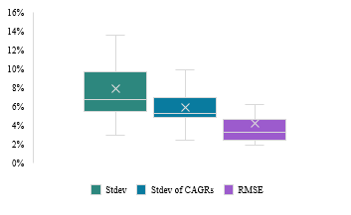
Forecast Error Is the Right Risk Metric for Long-Term, Hold-to-Maturity Investors
Traditional volatility (standard deviation of 1-year returns) exaggerates uncertainty for insurers, who reinvest and hold to maturity.
Root Mean Squared Forecast Error (RMSFE) captures the true risk: how far realized returns deviate from yield-based forecasts over 10 years.
Figure 5: Lower deviation in CAGRs compared to annual returns suggest mean reversion in returns, mainly driven by HY bonds, hybrids, and long-term indexes
1

Slide 8
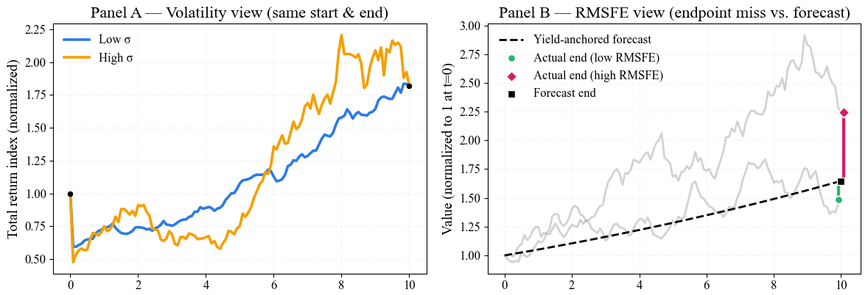
Volatility Is Not Long-Term Risk — RMSFE Captures What Actually Matters
Short-term volatility exaggerates risk for hold-to-maturity investors; mean reversion and compounding stabilize outcomes over time.
RMSFE measures forecast error around the yield-based return anchor, bundling reinvestment and credit-loss risk — the core uncertainties insurers face.
This horizon-adjusted view makes long-duration and credit assets more attractive, as their long-run outcomes are more stable than short-term noise suggests.
1

Slide 9
Private Equity Delivers Equity Beta and Growth, But Net Alpha is Illusory
Private equity behaves like a leveraged small-cap equity strategy, with higher equity beta, modest real growth advantage, and limited evidence of persistent alpha after fees.
Illiquidity premia are often overstated: investors tolerate reduced transparency and volatility smoothing in exchange for headline stability, not economic compensation.
Expected returns are modeled using a DCF framework: income yield (~3.6%) plus real growth and modest multiple expansion, adjusted for leverage, fees, and long-term inflation to arrive at a 7.0% net nominal return.
y_{u} | g_{u} | r_{u} = y_{u} + g_{u} | D/E | k_{d} | r_{l} = r_{u} + (D/E)*(r_{u} - k_{d}) | m | r_{g} = r_{l} + m | f | r_{r} = r_{g} - f | i | r = r_{r} + i
Income Yield | Real Growth Rate | Real Unlevered Return | Debt to Equity | Real Cost of Debt | Real levered Return | Multiple Expansion | Gross Real ER | Fees | Net Expected Real Return | Expected Inflation | Net Expected Return
3.6% | + 3.0% | = 6.6% | 52.0% | 3.1% | 8.4% | + 0.3% | = 8.7% | -4.0% | = 4.7% | + 2.3% | = 7.0%
7

Slide 10
Private Credit Modeled as Levered High-Yield Exposure
Private credit return expectations are built from high-yield credit excess returns, scaled by a leverage multiplier (1.2×) and adjusted for inflation.
This approach yields an expected nominal return of ~7.3% (geometric) with lower variance than direct HY exposure, reflecting the risk/return profile of institutional private credit portfolios.
HY credit expected real return | Cash real return | HY credit excess real return | Leverage multiplier | Expected PC real return (arithmetic average) | Variance of levered HY credit return (L^2*Var(HY)) | Expected PC real return (geometric average) | Expected inflation | Expected PC nominal return (geometric average)
5.2% | 1.6% | 3.5% | 1.2 | 5.9% | 1.9% | 5.0% | 2.3% | 7.3%
For real estate, unlevered expected returns are anchored in net operating income (NOI) minus recurring capital expenditures, yielding a real free cashflow return of ~3.1%.
Real growth is assumed to be negligible over long horizons, resulting in a nominal unlevered return of ~5.4% after adding expected inflation.
NOI yield | CapEx (~NOI/3) | Cashflow yield | Real growth | Unlevered real ER | Expected inflation | Unlevered nominal ER
4.7% | - 1.6% | = 3.1% | + 0.0% | = 3.1% | + 2.3% | = 5.4%
8

Slide 11
Every Asset Modeled with Yield Anchors, Capital Charges, and Horizon-Aligned Risk
 | Asset | Schdl. | Rating | NAIC | Capital Charge | Mat. (year) | Dur. (year) | Starting Yield | ECL | Expected Return | ER (Cap-Adjusted) | StDev | Long-term Uncertainty | WA Risk
Government | US Treasuries, Short/Intermediate | D-1 | AAA | 1A | 0.00% | 4.0 | 3.7 | 3.83% | 0.00% | 3.83% | 3.83% | 6.01% | 2.93% | 3.86%
 | US Treasuries, Long | D-1 | AAA | 1A | 0.00% | 22.1 | 13.8 | 4.80% | 0.00% | 4.80% | 4.80% | 13.57% | 6.36% | 8.52%
 | US Taxable Munis | D-1 | AA | 1C | 0.00% | 13.3 | 10.6 | 3.96% | 0.10% | 3.86% | 3.86% | 8.21% | 2.41% | 4.15%
 | Global ex-US Government, hedged | D-1 | AA | 1C | 0.42% | 9.7 | 8.3 | 3.07% | 0.10% | 2.97% | 2.80% | 3.99% | 4.24% | 4.17%
Public Corporates | US Public Corporates IG AAA | D-1 | AAA | 1A | 0.16% | 5.4 | 5.0 | 4.23% | 0.00% | 4.23% | 4.16% | 4.45% | 2.29% | 2.94%
 | US Public Corporates IG AA | D-1 | AA | 1C | 0.42% | 7.8 | 6.8 | 4.36% | 0.10% | 4.26% | 4.09% | 5.48% | 2.45% | 3.36%
 | US Public Corporates IG A | D-1 | A | 1F | 0.82% | 10.3 | 8.3 | 4.87% | 0.07% | 4.80% | 4.48% | 6.27% | 2.82% | 3.85%
 | US Public Corporates IG BBB | D-1 | BBB | 2B | 1.52% | 10.5 | 8.2 | 5.21% | 0.49% | 4.72% | 4.11% | 7.23% | 3.20% | 4.41%
 | US Public Corporates, HY Intermediate | D-1 | BB– | 3C | 6.02% | 4.5 | 3.9 | 7.04% | 0.67% | 6.37% | 3.96% | 12.46% | 12.80% | 12.70%
 | US Public Corporates, HY Long | D-1 | BB– | 3C | 6.02% | 16.3 | 9.5 | 7.87% | 0.67% | 7.20% | 4.79% | 18.04% | 8.94% | 11.67%
 | Global ex-US Corporates, hedged | D-1 | A | 1F | 0.82% | 7.0 | 6.2 | 3.92% | 0.07% | 3.85% | 3.52% | 5.99% | 1.12% | 2.58%
Structured | Residential Mortgage-Backed Securities | D-1 | AA | 1C | 0.00% | 7.8 | 6.7 | 4.93% | 0.10% | 4.83% | 4.83% | 8.15% | 3.09% | 4.61%
 | Commercial Mortgage-Backed Securities | D-1 | AA | 1C | 0.00% | 4.4 | 4.1 | 4.69% | 0.10% | 4.59% | 4.59% | 7.74% | 3.69% | 4.90%
 | Asset-Backed Securities | D-1 | AA | 1C | 0.42% | 3.6 | 3.3 | 4.41% | 0.10% | 4.31% | 4.14% | 5.82% | 5.49% | 5.59%
Private Credit | Corporate IG Private Placement A | D-1 | A | 1F | 0.82% | 10.3 | 8.1 | 5.52% | 0.07% | 5.45% | 5.13% | 5.34% | 2.78% | 3.55%
 | Corporate IG Private Placement BBB | D-1 | BBB | 2B | 1.52% | 10.5 | 8.0 | 5.84% | 0.49% | 5.35% | 4.75% | 5.70% | 3.20% | 3.95%
 | Corporate HY Private (Leveraged Loans) | D-1 | B+ | 4A | 7.39% | 4.7 | 3.9 | 7.99% | 2.42% | 5.57% | 2.62% | 14.43% | 8.94% | 10.58%
 | Residential Mortgage Whole Loans | B | AA | 1C | 0.68% | 7.7 | 6.4 | 4.90% | 0.10% | 4.80% | 4.52% | 2.86% | 3.09% | 3.02%
 | Commercial Mortgage Whole Loans | B | AAA | 1A | 0.90% | 4.4 | 4.1 | 4.76% | 0.00% | 4.76% | 4.40% | 13.15% | 6.62% | 8.58%
Illiq. | Private Equity | BA | - | - | 30.00% | - | - | 6.98% |  | 6.98% | 3.98% | - | - | 25.27%
 | Real Estate (via partnerships, equity) | BA | - | - | 30.00% | - | - | 5.40% |  | 5.40% | 2.40% | - | - | 17.5%
1

Slide 12
Surplus-Aware Optimizer Simulates Liability-Aligned, Capital-Efficient Frontiers
Element | Summary
Objective | Maximize expected return net of surplus volatility and capital charge.
Key Formula | max (μᵀw − λ(wᵀΣw) − ϕ(cᵀw))
Risk Aversion (λ) | Controls penalty for surplus volatility.
Capital Penalty (ϕ) | Penalizes capital-intensive allocations using NAIC RBC charges.
Robustness | Monte Carlo resampling across 100 capital market scenarios.
Portfolio Constraints | Asset weights: 0%–10%, Credit quality ≥ A+, BBB ≤ 15%, below IG ≤ 5%
Strategic Asset Limits | Alt/Strategic Assets ≤ 35%, Real Estate ≤ 5%, Private Credit ≤ 20%
Liability Matching | Duration within ±1Y of liabilities, optional key-rate duration (KRD) matching active
Framework reflects realistic insurer constraints and surplus-driven logic, not internal allocation tools.
1

Slide 13
Simulating Surplus Under Macro Risk Reveals RMSFE Portfolios Are Superior
A multi-factor model links asset returns to macro variables (rates, curve, credit spreads, equities), estimating both regime-specific sensitivities and idiosyncratic risk.
Joint simulations of assets and liabilities over 10,000 macro scenarios show that portfolios built with RMSFE risk outperformed those built with volatility risk, especially in terms of long-term surplus stability.
RMSFE portfolios deliver higher median surplus growth, lower shortfall risk, and greater capital efficiency, thanks to better alignment with long-horizon liability dynamics and macro risk structure.
Company | Δ Surplus CAGR (RMSFE–VOL) | Δ P(Surplus<0) | Δ Surplus/RBC
Brighthouse | +0.10% | −2.3 pp | +0.13
Corebridge | +0.12% | −2.3 pp | +0.17
MetLife | +0.10% | −1.5 pp | +0.17
Principal | +0.13% | −2.2 pp | +0.16
Prudential | +0.11% | −1.9 pp | +0.15
Voya | +0.11% | −1.6 pp | +0.19
1

Slide 14
SAA Requires a Forward-Looking, Institutionally Grounded CMA
This CMA framework is designed for long-term institutional investors, whose portfolios include fixed income and increasingly tilt toward private assets.
This framework constructs forward-looking return expectations and rigorous and practical risk measures grounded in asset-specific cash flow dynamics and starting valuations.
 | Asset | Schedule | Rating | NAIC Designation | Capital Charge X PAF | Duration | Expected Credit loss
Government | US Treasuries, Short/Intermediate | D-1 | AAA | 1A | 0.00% | 3.7 | 0.00%
 | US Treasuries, Long | D-1 | AAA | 1A | 0.00% | 13.8 | 0.00%
 | US Taxable Munis | D-1 | AA | 1C | 0.00% | 10.6 | 0.10%
 | Global ex-US Government, hedged | D-1 | AA | 1C | 0.42% | 8.3 | 0.10%
Public Corporates | US Public Corporates IG AAA | D-1 | AAA | 1A | 0.16% | 5.0 | 0.00%
 | US Public Corporates IG AA | D-1 | AA | 1C | 0.42% | 6.8 | 0.10%
 | US Public Corporates IG A | D-1 | A | 1F | 0.82% | 8.3 | 0.07%
 | US Public Corporates IG BBB | D-1 | BBB | 2B | 1.52% | 8.2 | 0.49%
 | US Public Corporates, HY Intermediate | D-1 | BB– | 3C | 6.02% | 3.9 | 0.67%
 | US Public Corporates, HY Long | D-1 | BB– | 3C | 6.02% | 9.5 | 0.67%
 | Global ex-US Corporates, hedged | D-1 | A | 1F | 0.82% | 6.2 | 0.07%
Structured | Residential Mortgage-Backed Securities | D-1 | AA | 1C | 0.00% | 6.7 | 0.10%
 | Commercial Mortgage-Backed Securities | D-1 | AA | 1C | 0.00% | 4.1 | 0.10%
 | Asset-Backed Securities | D-1 | AA | 1C | 0.42% | 3.3 | 0.10%
Private Credit | Corporate IG Private Placement A | D-1 | A | 1F | 0.82% | 8.1 | 0.07%
 | Corporate IG Private Placement BBB | D-1 | BBB | 2B | 1.52% | 8.0 | 0.49%
 | Corporate HY Private (Leveraged Loans) | D-1 | B+ | 4A | 7.39% | 3.9 | 2.42%
 | Residential Mortgage Whole Loans | B | AA | 1C | 0.68% | 6.4 | 0.10%
 | Commercial Mortgage Whole Loans | B | AAA | 1A | 0.90% | 4.1 | 0.00%
PE and PRE | Private Equity | BA |  |  | 30.00%
 | Real Estate (via partnerships, equity) | BA |  |  | 30.00%
1

Slide 15
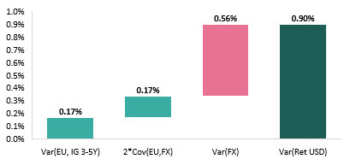
Cash and FX Risk Do Not Belong in Long-Term Strategic Allocation
Cash is excluded from return modeling due to its structural return deficiency, policy-driven volatility, and minimal long-term role in insurer portfolios; a fixed 1% allocation reflects its tactical liquidity function.
Foreign currency bonds are modeled using hedged indexes to strip out uncompensated FX volatility, aligning with institutional best practices that seek interest rate exposure, not currency noise.
Figure 1: Foreign currency volatility makes up the majority of the unhedged foreign currency bond risk
2

Slide 16
Fixed Income Return = Starting Yield Minus Expected Credit Loss
Asset owners earn yield by holding bonds to maturity, so expected returns are anchored in index yield-to-worst minus forward-looking credit loss estimates.
Expected returns are input as geometric (IRR) terms, avoiding mismatches from compounding or volatility drag.
Reinvestment risk is not forecasted path-wise but absorbed into the return RMSE metric, ensuring tractability and real-world alignment.
Figure 2: Starting yields are good indicators of actual performance
3

Slide 17
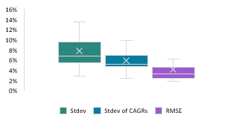
Mean Reversion Compresses Long-Term Risk Beyond What Volatility Suggests
Classical models assume i.i.d. returns and apply a “square-root-of-time” rule, but this overstates long-horizon risk by ignoring valuation-based predictability and mean reversion.
Maturity-matched analysis shows that fixed income, especially high yield and hybrids, exhibits significant mean reversion, shocks are often reversed as bonds pull to par and reinvestment stabilizes.
This compresses the dispersion of long-run outcomes, making CAGR-based risk metrics more realistic than standard deviation of annual returns for strategic planning.
Figure 3: Lower deviation in CAGRs compared to annual returns suggest mean reversion in returns, mainly driven by HY bonds, hybrids, and long-term indexes
4

Slide 18
Time Diversification Reveals the Strategic Value of High-Yield and Structured Bonds
Over multi-year horizons, volatility in HY and structured bonds falls sharply due to income compounding and mean-reverting spread shocks.
RMSE provides a more realistic measure of long-term forecast risk, reinforcing the case for longer-duration credit in surplus-maximizing portfolios.
Figure 4: Time diversification effect is most pronounced in HY securities
5

Slide 19
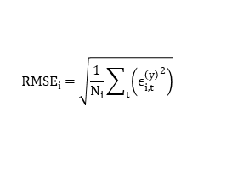


Risk Means Missing Long-Term Targets, Not Short-Term Volatility
I define risk as return forecast error, not mark-to-market swings, capturing both reinvestment and credit loss uncertainty via a 10-year RMSE metric, scaled to match volatility units.
The final risk input blends RMSE (70%) with standard deviation (30%) to reflect both long-term surplus risk and short-term regulatory sensitivity.
$${RMSE}_{i}=\sqrt{\frac{1}{N_{i}}\sum_{t}{\left({ϵ_{i,t}^{\left(y\right)}}^{2}\right)}}$$
$$ϵ_{i,t}^{\left(y\right)}=R_{i\left(t →t+10\right)}−Y_{i}\left(t\right)$$
$$σ=0.7∗RMSE+0.3∗Vol$$
Figure 6: Expected return and risk of fixed income indexes
6

Slide 20

Covariance Matrix Built from Horizon-Matched Risks and Empirical Co-Movement
Risk inputs are custom volatility measures tailored to long-term economic exposures
Correlations are empirically estimated from excess returns of public proxies, then combined with custom σ via the covariance identity:
$${Cov}_{i,j}=ρ_{i,j}∗σ_{i}∗σ_{j}$$
US Treasuries, Short/Intermediate | 1.0 | 0.9 | 0.5 | 0.8 | 0.9 | 0.7 | 0.6 | 0.5 | 0.0 | 0.1 | 0.7 | 0.8 | 0.2 | 0.3 | 0.2 | 0.1 | -0.4 | 0.2 | 0.2 | 0.0 | 0.0
US Treasuries, Long | 0.9 | 1.0 | 0.6 | 0.8 | 0.9 | 0.8 | 0.6 | 0.5 | 0.0 | 0.1 | 0.7 | 0.8 | 0.2 | 0.3 | 0.2 | 0.2 | 0.3 | 0.2 | 0.2 | 0.0 | 0.0
US Taxable Munis | 0.5 | 0.6 | 1.0 | 0.7 | 0.7 | 0.7 | 0.7 | 0.7 | 0.5 | 0.5 | 0.6 | 0.7 | 0.4 | 0.6 | 0.3 | 0.3 | 0.2 | 0.5 | 0.4 | 0.0 | 0.0
Global ex-US Government, hedged | 0.8 | 0.8 | 0.7 | 1.0 | 0.8 | 0.8 | 0.7 | 0.6 | 0.2 | 0.3 | 1.0 | 0.8 | 0.3 | 0.3 | 0.3 | 0.2 | -0.1 | 0.4 | 0.3 | 0.0 | 0.0
US Public Corporates IG AAA | 0.9 | 0.9 | 0.7 | 0.8 | 1.0 | 0.9 | 0.7 | 0.6 | 0.2 | 0.3 | 0.6 | 0.9 | 0.4 | 0.4 | 0.3 | 0.2 | 0.4 | 0.5 | 0.4 | 0.0 | 0.0
US Public Corporates IG AA | 0.7 | 0.8 | 0.7 | 0.8 | 0.9 | 1.0 | 1.0 | 0.9 | 0.5 | 0.6 | 0.6 | 0.8 | 0.5 | 0.5 | 0.4 | 0.4 | 0.4 | 0.5 | 0.5 | 0.0 | 0.1
US Public Corporates IG A | 0.6 | 0.6 | 0.7 | 0.7 | 0.7 | 1.0 | 1.0 | 0.9 | 0.6 | 0.7 | 0.6 | 0.7 | 0.6 | 0.6 | 0.4 | 0.4 | 0.4 | 0.5 | 0.6 | 0.1 | 0.1
US Public Corporates IG BBB | 0.5 | 0.5 | 0.7 | 0.6 | 0.6 | 0.9 | 0.9 | 1.0 | 0.8 | 0.8 | 0.6 | 0.6 | 0.6 | 0.7 | 0.5 | 0.5 | 0.4 | 0.5 | 0.6 | 0.0 | 0.0
US Public Corporates, HY Intermediate | 0.0 | 0.0 | 0.5 | 0.2 | 0.2 | 0.5 | 0.6 | 0.8 | 1.0 | 0.9 | 0.2 | 0.3 | 0.7 | 0.6 | 0.5 | 0.5 | 0.8 | 0.5 | 0.7 | 0.0 | 0.1
US Public Corporates, HY Long | 0.1 | 0.1 | 0.5 | 0.3 | 0.3 | 0.6 | 0.7 | 0.8 | 0.9 | 1.0 | 0.2 | 0.4 | 0.7 | 0.6 | 0.5 | 0.5 | 0.8 | 0.5 | 0.7 | 0.0 | 0.1
Global ex-US Corporates, hedged | 0.7 | 0.7 | 0.6 | 1.0 | 0.6 | 0.6 | 0.6 | 0.6 | 0.2 | 0.2 | 1.0 | 0.7 | 0.7 | 0.7 | -0.1 | -0.1 | -0.1 | 0.4 | 0.4 | -0.2 | -0.2
Residential Mortgage-Backed Securities | 0.8 | 0.8 | 0.7 | 0.8 | 0.9 | 0.8 | 0.7 | 0.6 | 0.3 | 0.4 | 0.7 | 1.0 | 0.3 | 0.4 | 0.2 | 0.2 | 0.0 | 0.5 | 0.3 | 0.0 | 0.0
Commercial Mortgage-Backed Securities | 0.2 | 0.2 | 0.4 | 0.3 | 0.4 | 0.5 | 0.6 | 0.6 | 0.7 | 0.7 | 0.7 | 0.3 | 1.0 | 0.4 | 0.5 | 0.4 | 0.0 | 0.5 | 1.0 | 0.0 | 0.2
Asset-Backed Securities | 0.3 | 0.3 | 0.6 | 0.3 | 0.4 | 0.5 | 0.6 | 0.7 | 0.6 | 0.6 | 0.7 | 0.4 | 0.4 | 1.0 | 0.5 | 0.4 | 0.0 | 0.5 | 0.5 | 0.0 | 0.1
Corporate IG Private Placement A | 0.2 | 0.2 | 0.3 | 0.3 | 0.3 | 0.4 | 0.4 | 0.5 | 0.5 | 0.5 | -0.1 | 0.2 | 0.5 | 0.5 | 1.0 | 1.0 | 0.7 | 0.5 | 0.5 | 0.2 | 0.2
Corporate IG Private Placement BBB | 0.1 | 0.2 | 0.3 | 0.2 | 0.2 | 0.4 | 0.4 | 0.5 | 0.5 | 0.5 | -0.1 | 0.2 | 0.4 | 0.4 | 1.0 | 1.0 | 0.7 | 0.5 | 0.4 | 0.1 | 0.2
Corporate HY Private | -0.4 | 0.3 | 0.2 | -0.1 | 0.4 | 0.4 | 0.4 | 0.4 | 0.8 | 0.8 | -0.1 | 0.0 | 0.0 | 0.0 | 0.7 | 0.7 | 1.0 | 0.4 | 0.4 | 0.7 | 0.4
Residential Mortgage Whole Loans | 0.2 | 0.2 | 0.5 | 0.4 | 0.5 | 0.5 | 0.5 | 0.5 | 0.5 | 0.5 | 0.4 | 0.5 | 0.5 | 0.5 | 0.5 | 0.5 | 0.4 | 1.0 | 1.0 | 0.4 | 0.3
Commercial Mortgage Whole Loans | 0.2 | 0.2 | 0.4 | 0.3 | 0.4 | 0.5 | 0.6 | 0.6 | 0.7 | 0.7 | 0.4 | 0.3 | 1.0 | 0.5 | 0.5 | 0.4 | 0.4 | 1.0 | 1.0 | 0.0 | 0.2
Private Equity | 0.0 | 0.0 | 0.0 | 0.0 | 0.0 | 0.0 | 0.1 | 0.0 | 0.0 | 0.0 | -0.2 | 0.0 | 0.0 | 0.0 | 0.2 | 0.1 | 0.7 | 0.4 | 0.0 | 1.0 | 0.7
Real Estate (via partnerships, equity) | 0.0 | 0.0 | 0.0 | 0.0 | 0.0 | 0.1 | 0.1 | 0.0 | 0.1 | 0.1 | -0.2 | 0.0 | 0.2 | 0.1 | 0.2 | 0.2 | 0.4 | 0.3 | 0.2 | 0.7 | 1.0
10

Slide 21
Equity Returns Anchored in Shareholder Cash Flows, Not Earnings Noise
Public equity expected returns are built bottom-up using sector-level dividend and buyback yields, not accounting-based metrics.
Cash yield measures are more robust than earnings, as they are harder to manipulate and directly reflect shareholder payouts.
Buybacks now rival dividends in size and are essential to capturing the true return potential of U.S. large-cap equities.
Figure 7: Buyback yields have considerably increased since 2012
11

Slide 22
Valuation and Structural Signals Refine Equity Return Expectations
Implied equity risk premia (ERP) are derived via a two-stage DDM, solving for cost of equity at the sector level.
This multi-layer approach ensures forward-looking return estimates reflect real sector dynamics.
$$P = ∑_\{t=1\}^\{5\} [D₀(1+g)^t / (1+r)^t] + [D₀(1+g)^5(1+g_\{term\})] / [(r − g_\{term\})(1+r)^5]$$
Figure 8: Implied ERP levels have been more volatile in the last decade
12

Slide 23
Valuation & Margin Trends Refine Cash-Based Equity Return Forecasts
Implied equity risk premia (ERP) are refined using sector-specific CAPE regressions and long-term profitability trends to capture valuation mispricing and structural shifts.
Only sectors with strong CAPE-return relationships (R² > 0.2) received valuation adjustments; profitability trends were layered on top for sectors with meaningful structural margin shifts.
These enhancements sharpen the signal from implied ERPs, ensuring return forecasts reflect both current prices and evolving fundamentals.
Figure 8: Implied ERP levels have been more volatile in the last decade
13

